Slide 1


K.RAMAKRISHNAN COLLEGE OF TECHNOLOGY
(AUTONOMOUS), TRICHY.
EMPLOYEE PAYROLL MANAGEMENT SYSTEM
PRESENTED
BHAWNA SRI B
2303811710422020
SUPERVISOR
Mr. M. Saravanan, M.E.,
AP/CSE.

Slide 2
PRESENTATION OVERVIEW
Objective
Project Introduction
Problem Statement
Methodologies (Programming concepts relevant to problem statement)
Architecture of the proposed system
List of Modules
Merits
Results and Discussion
Queries

Slide 3
OBJECTIVE
The objective of the Employee Payroll Management System (EPMS) is to design and develop a robust and automated solution that simplifies the payroll process for organizations.
The system aims to accurately calculate employee salaries, deductions, bonuses, and other compensations while ensuring compliance with tax regulations and organizational policies. By automating payroll operations, the system minimizes manual effort and reduces errors, streamlining the overall process.
It provides a secure and user-friendly platform, safeguarding sensitive employee data and offering an intuitive interface for HR administrators and employees alike.
Additionally, the EPMS facilitates the generation of detailed and customizable payroll reports, supports integration with existing HR and accounting systems, and is scalable to accommodate organizational growth.

Slide 4
PROJECT INTRODUCTION
The Employee Payroll Management System (EPMS) is a software solution designed to automate and simplify payroll processes within an organization. It streamlines tasks such as salary calculations, tax deductions, bonuses, and report generation while ensuring compliance with labor laws and organizational policies.
By replacing manual processes with automation, the EPMS reduces errors, saves time, and enhances efficiency.
The system includes features like secure data management, integration with HR systems, and a self-service portal for employees to access salary details and payslips.
With its user-friendly interface and robust functionality, the EPMS aims to improve payroll accuracy, reduce administrative workloads, and foster transparency and trust within the organization.

Slide 5
PROBLEM STATEMENT
Managing payroll is a critical yet complex task for organizations, involving calculations of salaries, taxes, deductions, bonuses, and compliance with labor laws. Manual payroll processes are time-consuming, prone to errors, and difficult to manage as the organization grows.
Errors in payroll can lead to employee dissatisfaction, financial losses, and potential legal issues. Additionally, maintaining secure and organized payroll data while ensuring easy accessibility for HR teams and employees remains a significant challenge.
The lack of an efficient, automated, and user-friendly system results in inefficiencies, reduced productivity, and increased administrative burdens.
This calls for a solution that not only automates payroll processing but also ensures accuracy, compliance, and data security, while providing employees with transparent access to their payroll information.

Slide 6
METHODOLOGIES
Classes and Objects
Classes: The Employee and Payroll Management System are classes that define the structure and
behavior of employees and the payroll system. ✓
Objects: Instances of the Employee class are created to represent individual employees.
2. Encapsulation
The program uses encapsulation by keeping the employee attributes (like name, employeeId, baseSalary)
private and providing public getter methods to access them, ensuring controlled access to the data.
3. Methods
Methods like calculateNetSalary() and printSalaryReport() define the behavior of the Employee class, and methods like addEmployee() and generatePayrollReport() manage the payroll system operations.

Slide 7
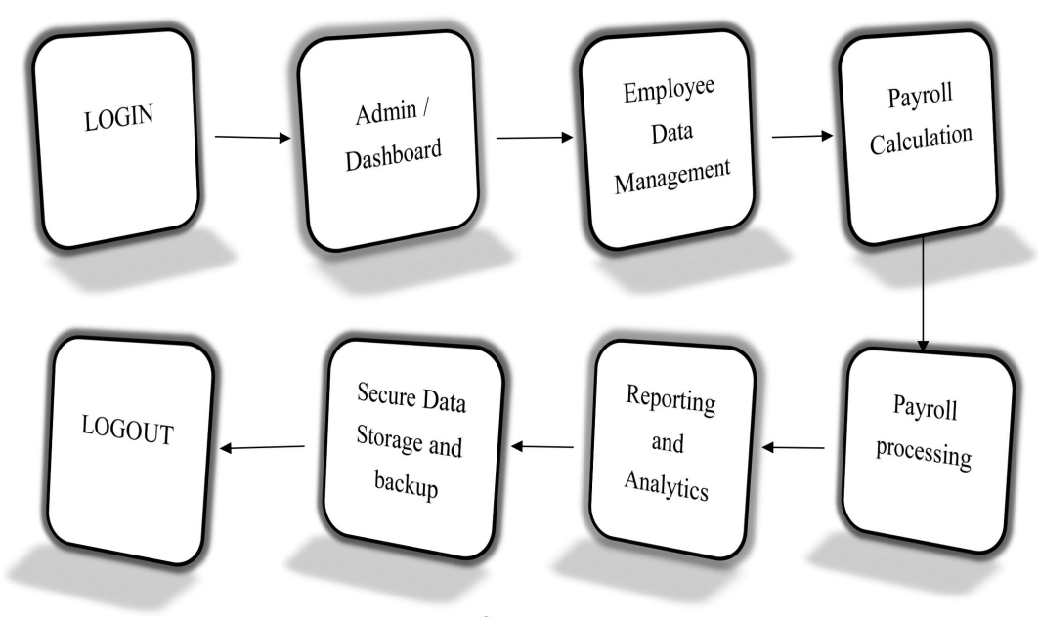
ARCHITECTURE OF THE PROPOSED SYSTEM

Slide 8
LIST OF MODULES
MODULE DESCRIPTON
1. Calculate Net Salary Module :
This module is responsible for calculating the net salary of an employee. It takes into account the employee's base salary, any applicable bonuses, and deductions (such as taxes, insurance, or other with holdings). The net salary is computed using the formula:
Net Salary = Base Salary + Bonus - Deductions
The module ensures that the employee's final salary is accurately calculated and is ready for
payroll processing. It can be invoked whenever an employee's salary details are required
2. Print Salary Report Module :
This module generates and displays a detailed salary report for an employee. It presents the employee’s personal and salary information, including the base salary, bonuses, deductions, and the calculated net salary. The report is printed to the console for review by HRadministrators or for any further processing, such as generating payslips or filing reports. This module ensures transparency and easy access to salary data for each employee.

Slide 9
LIST OF MODULES
MODULE DESCRIPTON
3. Add Employee Module :
This module allows HR administrators to add new employees to the payroll system. It prompts the user to input the necessary details for a new employee, such as name, employee ID, base salary, bonus, and deductions. Once the details are entered, a new Employee object is created, and the employee’s information is added to the list of employees in the system. This module enables the dynamic addition of employees to the payroll system and ensures that all employee data is properly stored for further payroll processing.
4. Display Menu Module
This module provides the primary user interface for interacting with the payroll system. It displays a menu with various options for the HR administrator, such as adding new employees, generating payroll reports, or exiting the system. The module uses a loop to allow continuous interaction until the user selects the exit option. This module is key to guiding the user through the system and ensuring easy access to system features in a structured manner.

Slide 10
MERITS
User-Friendly Interface : The menu-driven design simplifies interaction for users, making the system easy to navigate even for those with minimal technical knowledge.
Accuracy in Calculations : Automated calculations ensure precise computation of salaries, bonuses, and deductions, minimizing errors commonly associated with manual payroll management.
Saves Time: The system automates the payroll process, reducing the time spent on manually calculating salaries, bonuses, and deductions.By automating repetitive tasks like salary calculations, deductions, and bonus distribution, the system drastically reduces the time spent on manual payroll processing.
Reduces Errors: Since calculations are automated, there’s less chance of making mistakes in salary calculations, ensuring employees are paid correctly.The automated system eliminates these errors by following consistent rules for calculating salaries and deductions.
Transparency for Employees: Employees can easily access their salary details and reports, which builds trust and reduces confusion about pay.This transparency helps avoid misunderstanding .

Slide 11
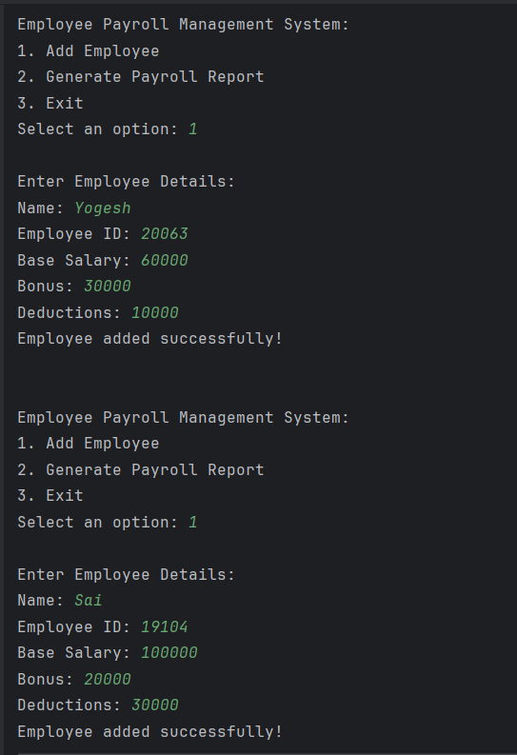
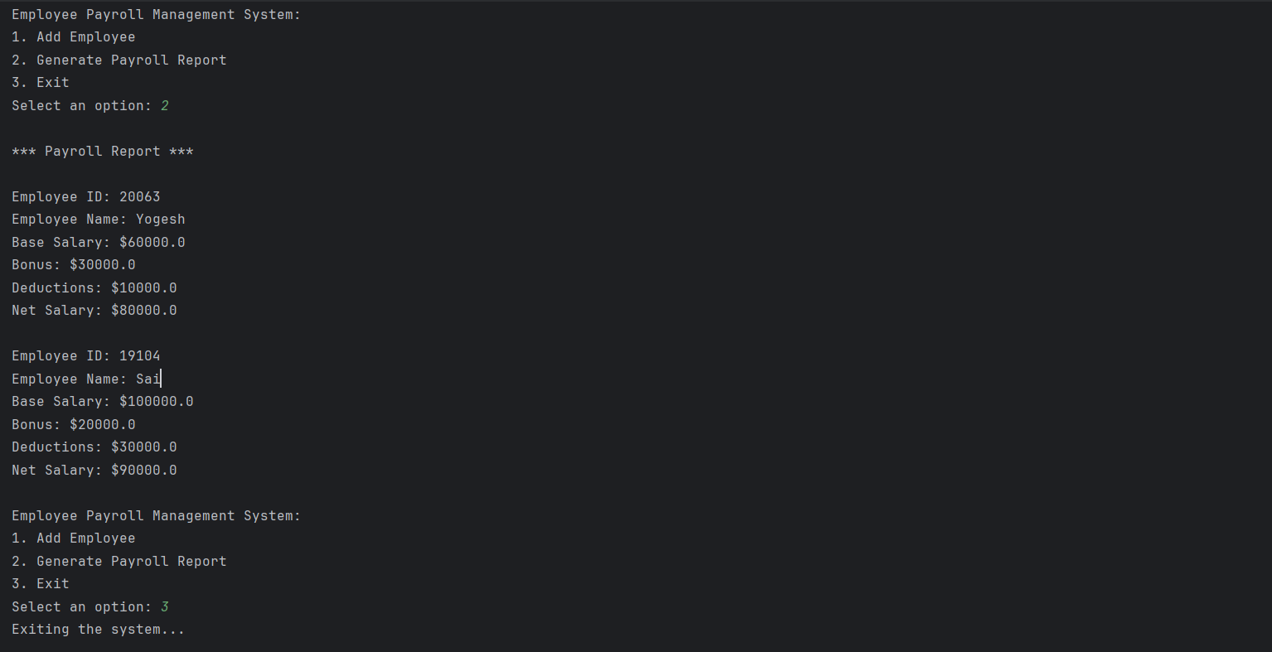
RESULTS AND DISCUSSION

Slide 12
QUERIES ?

